Slide 1

JavaScript - Control statements
Chitradevi M
Technical Trainer
KGiSL Micro College
KGiSL Campus, Coimbatore – 641 035.

Slide 2
JavaScript If-else
The JavaScript if-else statement is used to execute the code whether condition is true or false. There are three forms of if statement in JavaScript.
If Statement
If else statement
if else if statement
JavaScript If statement
It evaluates the content only if expression is true. The signature of JavaScript if statement is given below.
if(expression)
{
//content to be evaluated
}

Slide 3
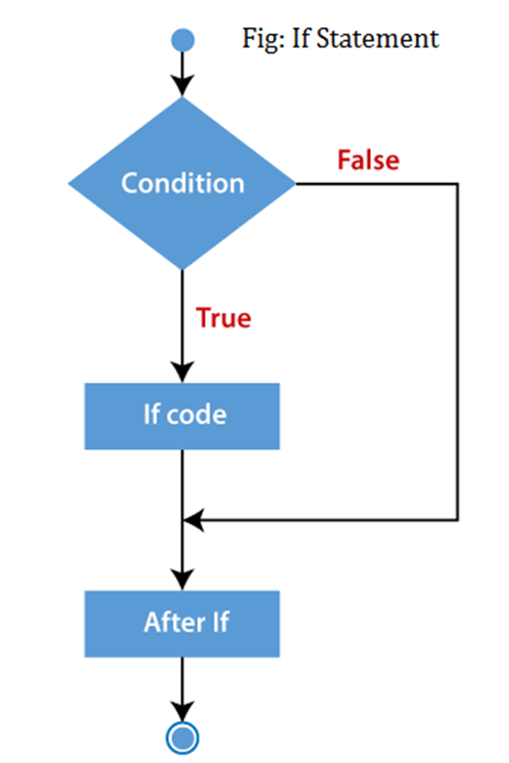
<html>
<body>
<script>
let a=20;
if(a>10){
console.log("value of a is greater than 10");
}
</script>
</body>
</html>

Slide 4
JavaScript If...else Statement
It evaluates the content whether condition is true of false. The syntax of JavaScript if-else statement is given below.
if(expression)
{
//content to be evaluated if condition is true
}
else
{
//content to be evaluated if condition is false
}

Slide 5
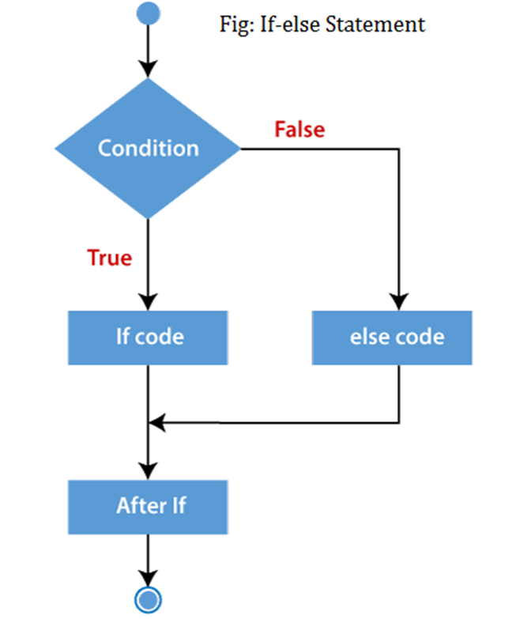
<html>
<body>
<script>
let a=20;
if(a%2==0){
console.log("a is even number");
}
else{
console.log("a is odd number");
}
</script>
</body>
</html>

Slide 6
JavaScript If...else if statement
It evaluates the content only if expression is true from several expressions.
The signature of JavaScript if else if statement is given below.
if(expression1){
//content to be evaluated if expression1 is true
}
else if(expression2){
//content to be evaluated if expression2 is true
}
else if(expression3){
//content to be evaluated if expression3 is true
}
else{
//content to be evaluated if no expression is true
}

Slide 7
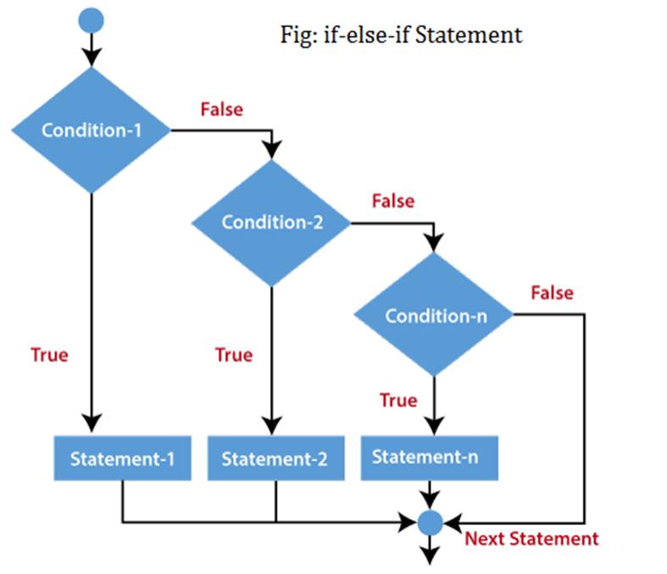

Slide 8
<html>
<body>
<script>
let a=20;
if(a==10){
console.log("a is equal to 10");
}
else if(a==15){
console.log("a is equal to 15");
}
else if(a==20){
console.log("a is equal to 20");
}
else{
console.log("a is not equal to 10, 15 or 20");
}
</script>
</body>
</html>

Slide 9
JavaScript Switch
The JavaScript switch statement is used to execute one code from multiple expressions. It is just like else if statement that we have learned in previous page.
But it is convenient than if..else..if because it can be used with numbers, characters etc.
The signature of JavaScript switch statement is given below.
switch(expression){
case value1:
code to be executed;
break;
case value2:
code to be executed;
break;
......
default:
code to be executed if above values are not matched;
}

Slide 10
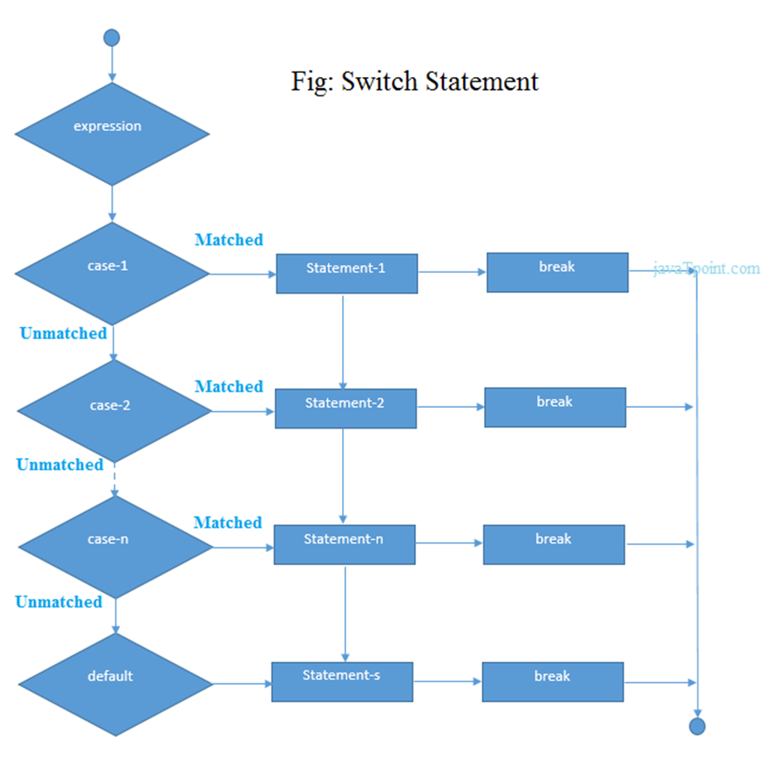

Slide 11
<!DOCTYPE html>
<html>
<body>
<script>
let grade='B';
let result;
switch(grade){
case 'A':
result="A Grade";
break;
case 'B':
result="B Grade";
break;
case 'C':
result="C Grade";
break;
default:
result="No Grade";
}
console.log(result);
</script>
</body>
</html>

